Slide 1

Multilingual embeddings using ACS
Mentors
Micheal Wick and Pallika Kannani
- Nitin Kishore

Slide 2
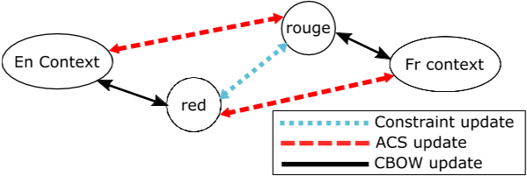
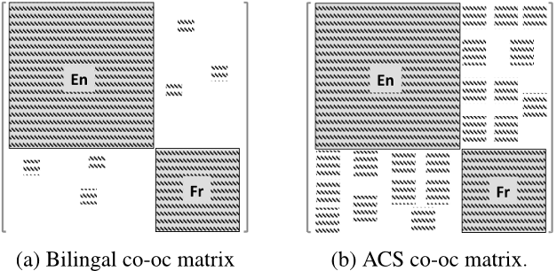
artificial code switching (ACS)
- I have a gato
- I have un cat
- Yo tengo a cat
Yo tengo un gato ~ I have a cat
EXPECTATION :
vec(“king”) - vec(“man”)+ vec(“woman”) ≈ vec(“queen”)
vec(“roi”) - vec(“homme”) + vec(“femme”) ≈ vec(“reine”)
vec(“roi”) - vec(“hombre”) + vec(“woman”) ≈ vec(“reina”)

Slide 3
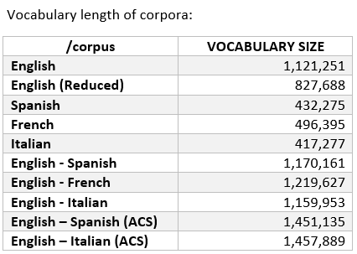
------Corpus Statistics------ (Wikipedia Dumps)
INPUT : A large corpus of multilingual text
OUTPUT : A single, unified word embedding in which the word vectors generalize across languages.
(H1): Word embeddings provide sufficient information for training accurate NLP models; (H2): Monolingual word embeddings in different languages have similar structure; (H3): A small set of constraints is sufficient for learning this shared structure (H4): The shared structure is sufficient for generalizing NLP models from one language to another.

Slide 4
Word2vec questions-words.txt
Category | Example
capital-common-countries | Tokyo : Japan :: Rome : Italy
capital-world | Baghdad : Iraq :: Copenhagen : Denmark
currency | India : rupee :: USA : dollar
city-in-state | Houston : Texas :: Boston : Massachusetts
family | groom : bride :: stepbrother : stepsister
gram1-adjective-to-adverb | amazing : amazingly :: professional: professionally
gram2-opposite | clear : unclear :: informed : uninformed
gram3-comparative | bad : worse :: strong :stronger
gram4-superlative | bright : brightest :: weird : weirdest
gram5-present-participle | code : coding :: describe : describing
gram6-nationality-adjective | China : Chinese :: Mexico : Mexican
gram7-past-tense | decreasing : decreased :: selling : sold
gram8-plural | banana : bananas :: woman : women
gram9-plural-verbs | enhance : enhances :: predict : predicts

Slide 5
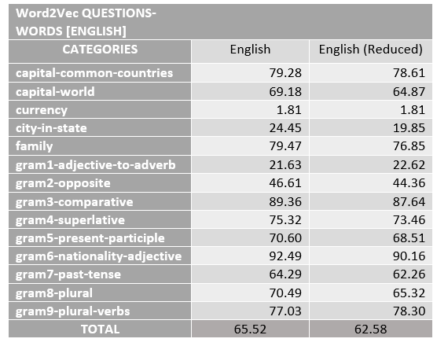
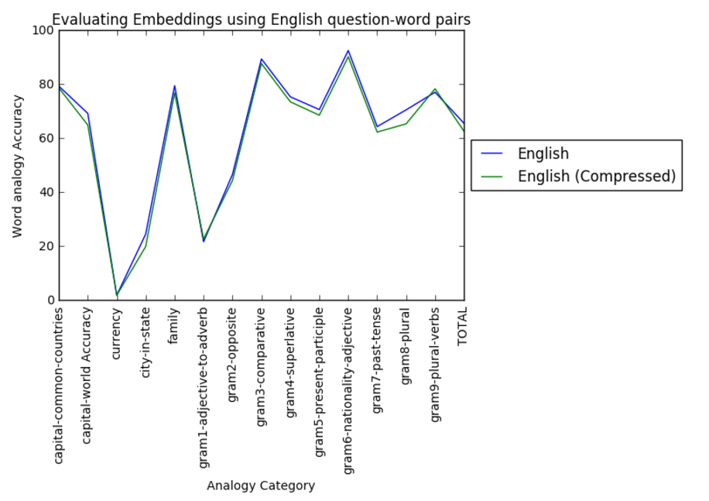
Evaluating embeddings using Analogy- Pairs

Slide 6
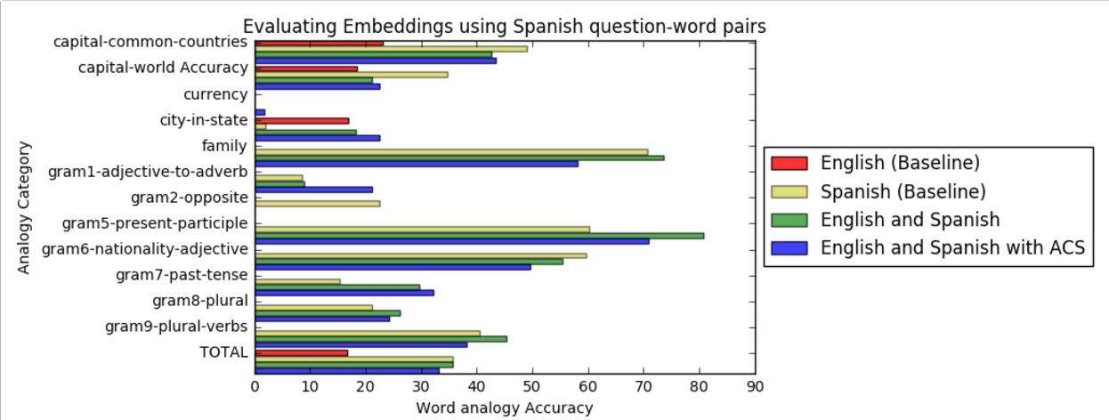

Slide 7
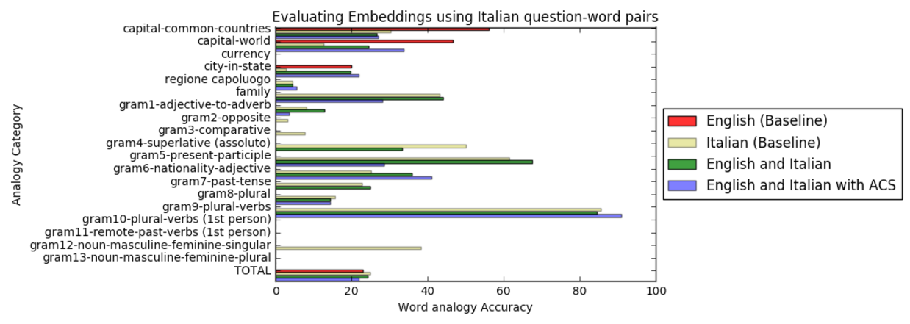

Slide 8
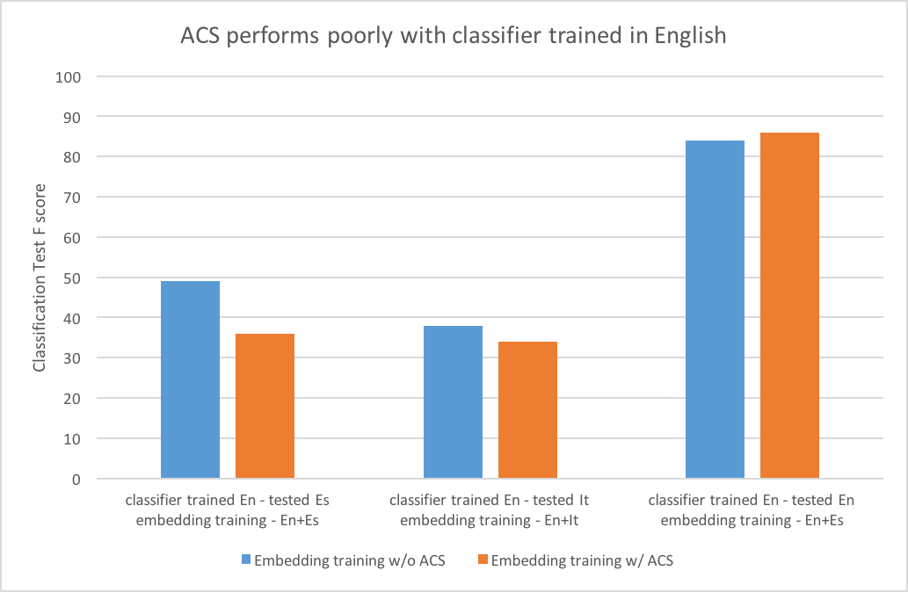
Extrinsic evaluation

Slide 9
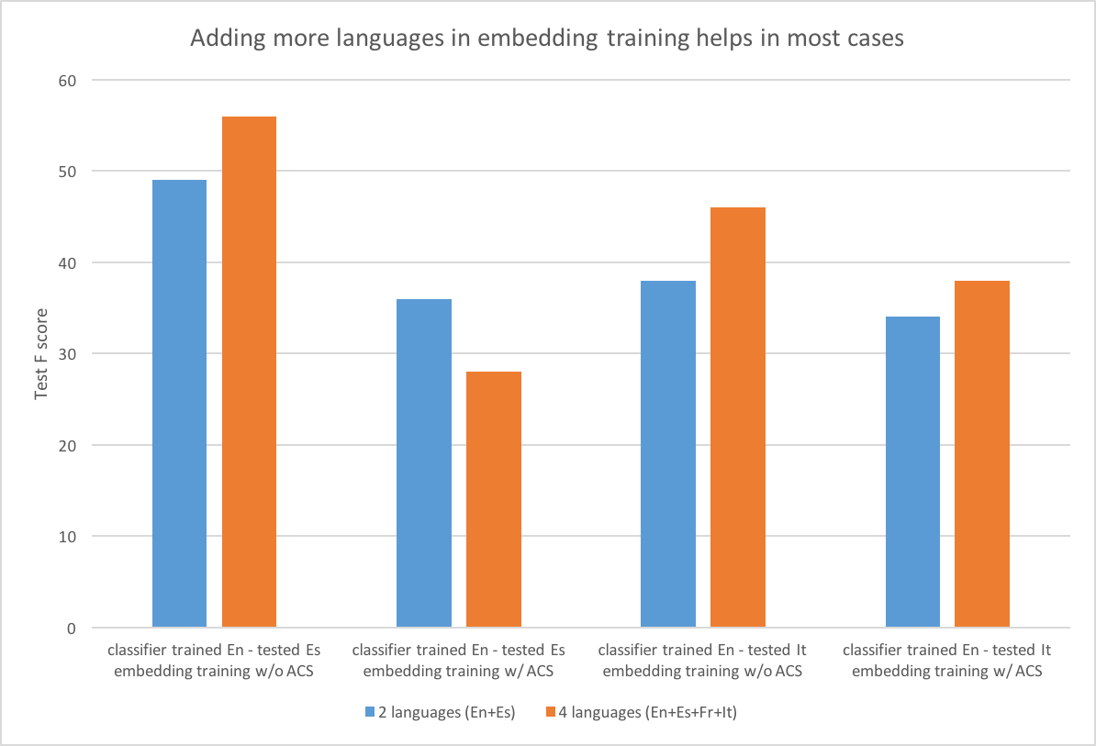

Slide 10
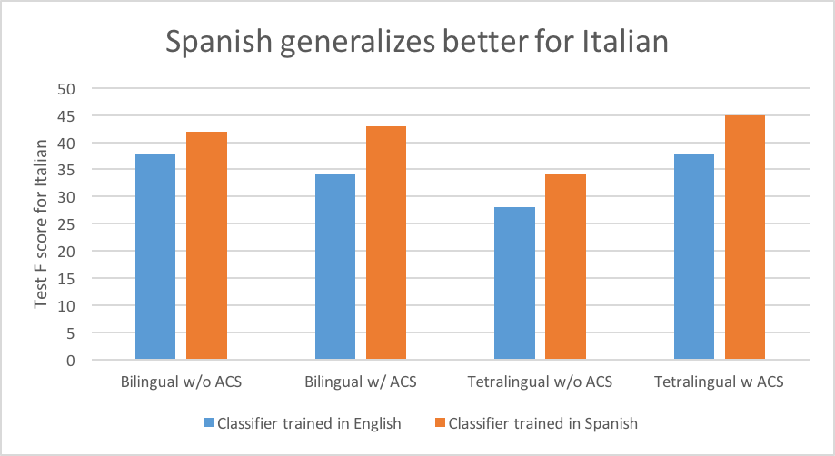

Slide 11
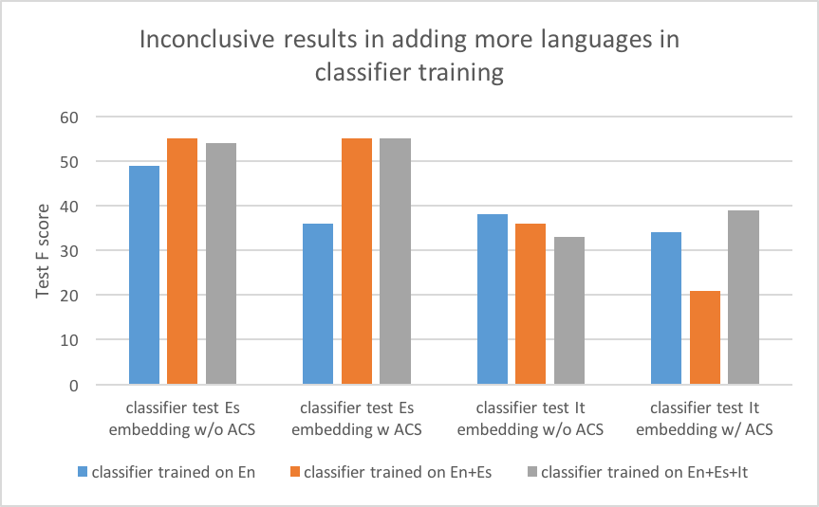

Slide 12
conclusions
Certain pairs of languages are better at generalizing (Spanish - Italian)
ACS performs poorly - multiple sweeps of code switching needed
Adding more languages for embedding training generally seems to help
Adding more languages to classifier training has mixed results
Problems encountered :
Word Sense Disambiguation
Linguistic complexities
Cultural diversity

Slide 13
Future work
Improve ACS (word sense disambiguation, evaluation with concept cosine similarity, phrase level switch)
ACS hyper parameter sweep (switch threshold)
Test performance and generalizability (evaluation on other NLP tasks, new languages)
Improve evaluation task approach (phrase-level/ document-level features, better algorithms)

Slide 14


